Slide 1
Understanding Harmony in Family
Unit 03

Slide 2
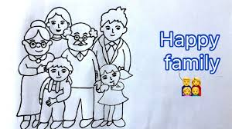
Harmony in the Family
What is Family?
What are reasons of Problems in a Family
How to sort out these problems?

Slide 3
Family
Family : It is group of person who are connected by blood within two or three generations. A group that consists of Parents and their children.
Family is the Basic Unit of all Interactions: We share our feelings and interests with them and have an affinity (attraction towards) to them.
There are individuals in a family
Human – Human Relationship
The major issues are not due to lack of physical facilities but due to lack of relationship

Slide 4
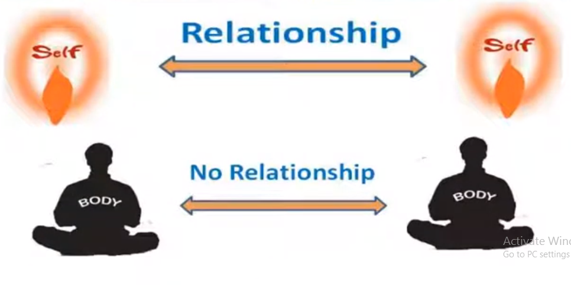
Set of Proposals to verify Harmony in the Family
1.
Relationship is and it exits between on Self (‘I’) and the other Self (‘I’)

Slide 5
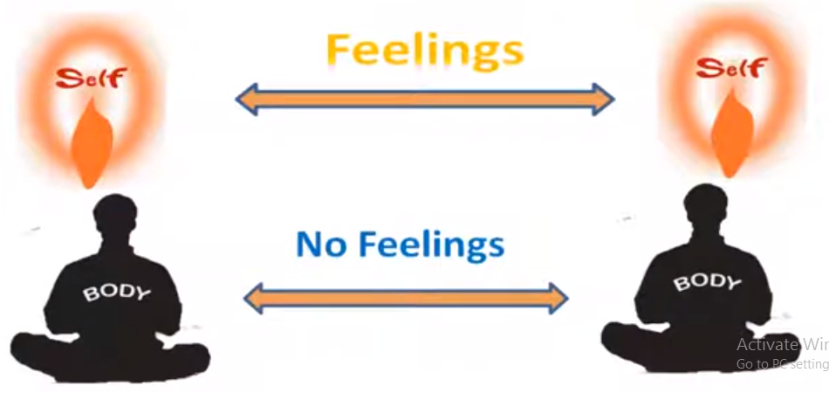
Set of Proposals to verify Harmony in the Family
2.
The Self (‘I’) has feelings in a relationship. These feelings are between (‘I’) and (‘I’)

Slide 6
Set of Proposals to verify Harmony in the Family
3.
The feelings of "I" (or one's personal emotions, thoughts, or experiences) are clear and certain. They can be recognized and understood without confusion or doubt. In simpler terms, it suggests that when you feel something, you know exactly what that feeling is and can identify it confidently. That are :
These feelings in the (‘I’) are definite. i.e. they can be identified with definiteness

Slide 7
9 definite feelings in the (‘I’) are
Trust
Respect
Affection
Care
Guidance
Reverence
Glory
Gratitude
Love

Slide 8
Set of Proposals to verify Harmony in the Family
We mainly focus on fulfillment of physical facilities and ignore feelings
Physical facilities = Need of Body
Feelings = Need of Self

Slide 9
4. Recognizing and Full filing these feelings lead to Mutual Happiness in a relationship
Recognition
Fulfillment
Evaluation
Mutual Happiness
When all four are ensured justice is ensured
Harmony
Satisfaction of both

